Slide 1
DATA ANALYTICS
Descriptive Analytics
Missing Values and Outliers
Session 4
Dr. Pouyan Eslami Fall 2024
CSUN

Slide 2
DATA ANALYTICS
Missing Values
Session 4
Dr. Pouyan Eslami Fall 2024
CSUN

Slide 3
Missing Values
Most real data sets have gaps in the data.
There are two issues: how to detect these Missing Values and what to do about them.
The more important issue is what to do about them:
One option is to simply ignore them. Then you will have to be aware of how the software deals with missing values.
Another option is to fill in missing values with the average of nonmissing values, but this isn’t usually a very good option.
A third option is to examine the nonmissing values in the row of a missing value; these values might provide clues on what the missing value should be.

Slide 4
Dealing With Missing Values
Missing values often occur in datasets due to various reasons like data entry errors, measurement failures, or intentional omission. These missing values can be problematic in data analysis and machine learning algorithms.
Key Strategies:
Removing missing values
Imputation (filling in missing values)

Slide 5
Sample 1.
Explanation:
dropna(): Removes rows or columns with missing
data.fillna(): Fills missing values with a specific value or method (e.g., mean, median).
method='ffill' or method='bfill': Forward and backward filling based on the previous or next value.

Slide 6
Removing Missing Values
Removing missing values involves deleting rows or columns from a dataset that contains missing data. There are two common approaches:
Row-wise removal: The entire row is removed if a row contains a missing value in any column.
Column-wise removal: If a column contains missing values, the entire column is removed.

Slide 7
Python Code
# Removing rows with missing values
df_dropped_rows = df.dropna()
# Removing columns with missing values
df_dropped_columns = df.dropna(axis=1)

Slide 8
Pros of Removing Missing Values
Pros:
Simple and effective: Removes the issue of missing data entirely, simplifying subsequent data analysis.
No assumptions: You don't need to make any assumptions about the missing data, so it avoids potential bias from imputation.

Slide 9
Cons of Removing Missing Values
Cons:
Loss of information: By removing rows or columns, you may lose valuable data, especially if missing values are frequent.
Skewing of results: If the missing values are not randomly distributed, removing rows or columns could introduce bias in the dataset.
Not feasible with large gaps: If a significant portion of your data is missing, removing rows or columns can lead to a drastically reduced dataset, making analysis difficult or even invalid.

Slide 10
When to Remove Missing Values
When the percentage of missing values is small, and their removal doesn't result in significant data loss or bias.
When data points are entirely random, and the missing values are not systematically related to other variables.

Slide 11
Imputation (Filling in Missing Values)
Imputation involves filling in missing data with estimated values. There are several common methods for imputation:

Slide 12
Mean Imputation
Replaces missing values with the mean of the column.
df_filled_mean = df.fillna(df.mean(numeric_only=True))

Slide 13
Mean Imputation – Pros and Cons
Pros:
Easy to implement: Simple and quick to apply.
Retains dataset size: No rows or columns are removed, so all data points are retained.
Cons:
Ignores variability: Replacing missing values with the mean can underestimate variability in the data, which could lead to inaccurate results.
Assumes data is normally distributed: Mean imputation assumes that data is symmetrically distributed, which may not be true for all datasets.

Slide 14
Median Imputation
Replaces missing values with the median of the column.
df_filled_median = df.fillna(df.median(numeric_only=True))

Slide 15
Median Imputation – Pros and Cons
Pros:
More robust to outliers: Since the median is less affected by extreme values than the mean, it’s better for skewed data.
Retains dataset size: No data points are removed.
Cons:
Ignores variability: Like mean imputation, this method can ignore the true variability in the data.
Less accurate for normally distributed data: If the data is normally distributed, median imputation may not reflect central tendencies or mean imputation.

Slide 16
Mode Imputation
Replaces missing values with the most frequent value in the column.
df_filled_mode = df.fillna(df.mode().iloc[0])

Slide 17
Mode Imputation – Pros and Cons
Pros:
Best for categorical data: Mode imputation works well when dealing with categorical variables (e.g., filling in missing gender or country values).
Cons:
Not suitable for continuous data: Mode imputation can lead to inaccuracies when applied to continuous numerical data.
Bias towards frequent categories: It can introduce bias by over-representing the most frequent category.

Slide 18
Forward Fill and Backward Fill
Forward Fill: Fills missing values with the preceding value.
Backward Fill: Fills missing values with the subsequent value.
df_ffill = df.fillna(method='ffill')
df_bfill = df.fillna(method='bfill')

Slide 19
Forward Fill and Backward Fill – Pros and Cons
Pros:
Useful in time series: Forward and backward filling are particularly useful in time series data where previous or subsequent values are logical substitutions.
Cons:
May propagate errors: If the previous or next values are incorrect or missing for a reason, forward or backward fill can propagate that error.
Assumes continuity: It assumes that the previous or next value is a reasonable estimate, which might not always be true.

Slide 20
K-Nearest Neighbors (KNN) Imputation
Fills missing values based on the most similar data points (neighbors).
from sklearn.impute import KNNImputer
imputer = KNNImputer(n_neighbors=3)
df_filled_knn = pd.DataFrame(imputer.fit_transform(df), columns=df.columns)

Slide 21
K-Nearest Neighbors (KNN) Imputation – Pros and Cons
Pros:
Accounts for relationships between features: This method uses the similarity between data points to impute missing values, making it more accurate than simple statistical methods.
No assumptions about data distribution: KNN works without assumptions about the underlying data distribution.
Cons:
Computationally expensive: KNN imputation can be slow, especially with large datasets.
Requires well-defined relationships: It works best when there are clear patterns in the data, and missingness isn't random.

Slide 22
Multiple Imputation
Instead of filling missing values with a single estimate, multiple imputation fills missing values several times with plausible estimates, creating multiple versions of the dataset for analysis.
from fancyimpute import IterativeImputer
imputer = IterativeImputer()
df_filled_multiple = pd.DataFrame(imputer.fit_transform(df), columns=df.columns)

Slide 23
Multiple Imputation – Pros and Cons
Pros:
More accurate: By generating multiple plausible datasets, it accounts for the uncertainty around the missing data.
Reduces bias: Multiple imputation reduces bias better than single imputation techniques.
Cons:
Complex: Multiple imputation is computationally intensive and conceptually more complicated.
Not always necessary: For smaller datasets, this might be overkill.

Slide 24
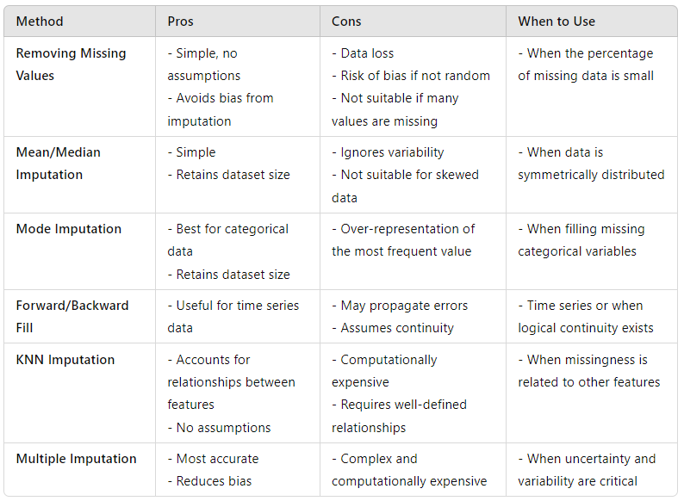
Dealing with Missing Values – Pros and Cons

Slide 25
DATA ANALYTICS
Outliers
Session 4
Dr. Pouyan Eslami Fall 2024
CSUN

Slide 26
Outliers and Missing Values
An outlier is a value or an entire observation (row) that lies well outside of the norm.
Some statisticians define an outlier as any value more than three standard deviations from the mean, but this is only a rule of thumb.
Even if values are not unusual by themselves, there still might be unusual combinations of values.
When dealing with outliers, it is best to run the analyses two ways: with the outliers and without them.

Slide 27
Dealing with Outliers
Introduction:
Outliers are data points significantly different from others. They can arise due to measurement errors, data entry errors, or true variability in data.
Key Strategies:
Detecting outliers using statistical methods (e.g., Z-score, IQR)
Removing or capping outliers

Slide 28
Sample 2 Explanation
Explanation:IQR (Interquartile Range): Used to detect outliers.
Data points outside the range of Q1 - 1.5 * IQR and Q3 + 1.5 * IQR are considered outliers.
Removing outliers: Eliminates these extreme values.
Capping outliers: Limits extreme values to a predefined threshold instead of removing them.

Slide 29

Advanced Outlier Detection Using Z-score
The Z-score (or standard score) is a statistical measure that describes the number of standard deviations a data point is from the mean of the dataset. It helps to identify how far away a value is from the mean and is widely used for detecting outliers in data.
Formula: The Z-score for a value 𝑥𝑖 is calculated as:

Slide 30
Advanced Outlier Detection Using Z-score
Where:
Z is the Z-score,
xi is the data point being evaluated,
μ\mu is the mean of the dataset,
σ\sigma is the standard deviation of the dataset.

Slide 31
Advanced Outlier Detection Using Z-score
Steps to Calculate Z-score:
Calculate the mean (μ\mu):
Sum all the data points and divide by the number of data points.
Calculate the standard deviation (σ\sigma):
Take the square root of the average of the squared differences from the mean.
Apply the Z-score formula:
For each data point xi, subtract the mean and divide by the standard deviation.

Slide 32
Advanced Outlier Detection Using Z-score
Interpretation of Z-score:
Z-score = 0: The data point is exactly at the mean.
Z-score > 0: The data point is above the mean.
Z-score < 0: The data point is below the mean.

Slide 33
Advanced Outlier Detection Using Z-score
Common Thresholds:
Z-scores beyond ±3 are often considered outliers because the probability of a data point falling more than 3 standard deviations away from the mean is very low (~0.3%).

Slide 34
Advanced Outlier Detection Using Z-score
How Z-Score is Used for Outlier Detection:
Calculate Z-scores for each data point in the dataset.
Set a threshold (commonly 3 or -3). Any data point with a Z-score greater than 3 or less than -3 is flagged as an outlier.
Handle the outliers: You can remove them, cap them, or take other measures depending on the context.

Slide 35
Z_Score_Sample
Z-score Calculation: The scipy.stats.zscore() function is used to compute Z-scores for the Age column.
Each data point is transformed to its Z-score.
Threshold: We use a threshold of ±3 to identify outliers.Outlier Detection: Any data point with a Z-score greater than 3 (or less than -3) is considered an outlier (in this case, 200).

Slide 36
Z-score Advantages for Outlier Detection
Standardization: It scales data points based on their relation to the mean and standard deviation, making it easier to spot extreme values.
Applicable to normal distributions: Works well for normally distributed data, where most data points cluster around the mean.
Threshold flexibility: The threshold for Z-scores (usually 3) can be adjusted based on the sensitivity of the analysis.

Slide 37
Z-score Limitations
Not suitable for non-normal distributions: Z-scores assume the data follows a normal distribution. For skewed data, it may not correctly identify outliers.
Sensitive to mean and standard deviation: The dataset's mean and standard deviation highly influence the calculated Z-scores, so a few extreme outliers can affect them.

Slide 38
Advanced Outlier Detection Using Z-score –Sample 2
Z-score: Measures how many standard deviations a data point is from the mean. A Z-score > 3 typically indicates an outlier.

Slide 39
Dealing With Missing Values and Outliers
Let’s do another practice.

Slide 40
Class Activity – Student_Grades.CSV
Handle Missing Data:
Use different techniques (mean, median, mode, forward fill, backward fill) to impute missing values for MathScore, EnglishScore, ScienceScore, and Attendance.
Discuss the impact of removing rows with missing values versus imputing the missing values.

Slide 41
Class Activity – Student_Grades.CSV
Handle Outliers:
Detect and remove/cap the outlier in the Age column.
Use both the IQR and Z-score methods to detect outliers in MathScore or other score columns.

Slide 42
Class Activity – Student_Grades.CSV
Discussion:
Which methods are most appropriate for each column? Should Attendance be treated differently from MathScore?
How does the removal or imputation of missing values affect the overall dataset and its statistical properties?

